Slide 1
CSE- 271 Software Engineering
Lecture -7

Slide 2
Topics covered
Software Project Planning and Management
  Project Scope
  Project Feasibility
    Estimation

Slide 3
Project Management - Aim
To complete a project:
  • On time
  • On budget
  • With required functionality
  • To the satisfaction of the client
  • Without exhausting the team
To provide visibility about the progress of a project

Slide 4
Aspects of Project Management
Planning
• Outline schedule during feasibility study
• Detailed schedule at the beginning of a project or phase of a project
Progress tracking
• Regular comparison of progress against plan
Final analysis
• Analysis of project for improvements during next project

Slide 5
Software Project Planning
Software project management begins with a set of activities that are collectively called project planning.
The objective of software project planning is to provide a framework that enables the manager to make reasonable estimates of resources, cost, and schedule. These estimates are made within a limited time frame at the beginning of a software project and should be updated regularly as the project progresses.
Planning also include risk analysis, change management activities

Slide 6
Project Planning Methods
Critical Path Method, Gantt charts, Activity bar charts, etc.
  • Build a work-plan from activity data.
  • Display work-plan in graphical form.
Project planning software (e.g., Microsoft Project)
  • Maintain a database of activity data with input tools
  • Calculate and display schedules
  • Provide progress reports

Slide 7
Critical Path – A Simple Example
Estimate duration of activities
Identify the longest path in the network (critical path)
A+B+E = 45
A+C+E = 40
A+C+F = 35
D+C+E = 55
D+C+F = 50
Task B
Task A
20 mins
Task E
Start
15 mins
10 mins
End
Task C
15 mins
Task D
Task F
30 mins
5 mins
Calculate path durations from task durations

Slide 8
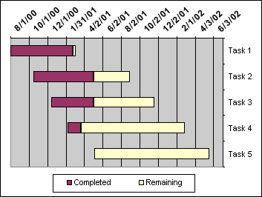
Gantt Chart
Dates run along the top (days, weeks or months).
• Each row represents an activity. Activities may be scheduled sequentially, in parallel or overlapping.
• The schedule for an activity is a horizontal bar. The left end marks the planned beginning of the task. The right end marks the expected end date.

Slide 9
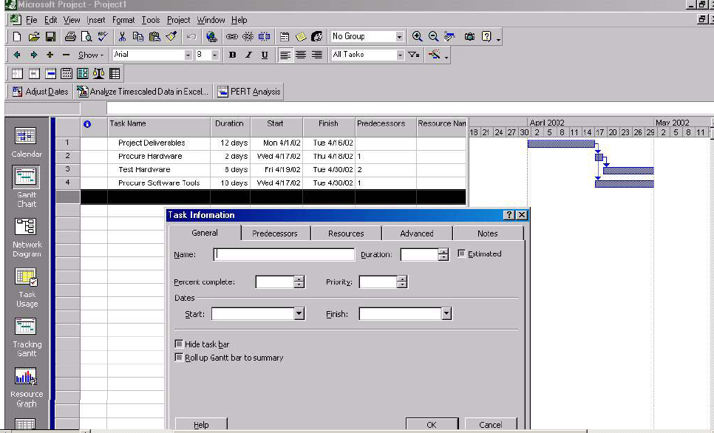
Microsoft Project

Slide 10
Activities in Project Planning
Determining Software Scope
Determining Project Feasibility

Slide 11
Estimation
It includes estimation of resources, cost and schedule
Following factors can effect project estimation
  Project Complexity
  Project Size
  Degree of Structural Uncertainty
    Probability of the occurrence of an unanticipated event due to the particular configuration of a system.

Slide 12
A Key Note
It is not always politically acceptable to modify initial estimates. A mature software organization and its managers recognize that change is not free. And yet, many customers demand (incorrectly) that an estimate once made must be maintained regardless of changing circumstances.

Slide 13
Project Scope
The first activity in software project planning is the determination of software scope.
Software scope describes the data and control to be processed, function, performance, constraints, interfaces, and reliability
Functions described in the statement of scope are evaluated and in some cases refined to provide more detail prior to the beginning of estimation

Slide 14
Project Scope
When people talk about scope, they immediately think time and cost. Time and cost are outputs of scope. Determining scope is a different exercise.
When we talk about defining the scope, we are talking about developing a common understanding as to what is included in, or excluded from, a project. We are not talking about deciding how long it will take, or how much it will cost. That comes after the scope is defined.

Slide 15
Defining Project Scope
A Q/A session between the company and customer may help to start the communication and help to define project scope.

Slide 16
Example Questions in Project Scope Q/A Session
Who is behind the request for this work?
Who will use the solution?
What will be the economic benefit of a successful solution?
Is there another source for the solution?
How would you (the customer) characterize "good" output that would be generated by a successful solution?
What problem (s) will this solution address?
Can you show me (or describe) the environment in which the solution will be used?

Slide 17
Project Feasibility
Once scope has been identified (with the concurrence of the customer), it is reasonable to ask: “Can we build software to meet this scope”?
Software feasibility has 4 solid dimensions:
  Technology— Is a project technically feasible? Is it within the state of the art? Can defects be reduced to a level matching the application’s needs?
  Finance—Is it financially feasible? Can development be completed at a cost the software organization, its client, or the market can afford?
  Time—Will the project’s time-to-market beat the competition?
  Resources—Does the organization have the resources needed to succeed?

Slide 18
What are Resources
Human Resources
  The number of people required for a software project can be determined only after an estimate of development effort (e.g., person-months) is made.
Reusable Software Resources
  Off-the-Shelf Components
  Full Experience Components
  Partial-experience components
  New components
Environmental Resources

Slide 19
Reusable Software Resources
Off-the-shelf components. Existing software that can be acquired from a third party or that has been developed internally for a past project.
Full-experience components. Existing specifications, designs, code, or test data developed for past projects that are similar to the software to be built for the current project.

Slide 20
Reusable Software Resources
Partial-experience components. Existing specifications, designs, code, or test data developed for past projects that are related to the software to be built for the current project but will require substantial modification.
New components. Software components that must be built by the software team specifically for the needs of the current project.

Slide 21
Reusable Software Resources
If off-the-shelf components meet project requirements, acquire them. The cost for acquisition and integration of off-the-shelf components will almost always be less than the cost to develop equivalent software. In addition, risk is relatively low.
If full-experience components are available, the risks associated with modification and integration are generally acceptable. The project plan should reflect the use of these components.
If partial-experience components are available, their use for the current project must be analyzed. If extensive modification is required before the components can be properly integrated with other elements of the software, proceed carefully—risk is high. The cost to modify partial-experience components can sometimes be greater than the cost to develop new components.

Slide 22
Environmental Resources
The environment that supports the software project, often called the software engineering environment (SEE), incorporates hardware and software

Slide 23
Software Project Estimation
To achieve reliable cost and effort estimates, a number of options arise:
Impossible to estimate system dev cost accurately at an early stage. Delay estimation until late in the project (obviously, we can achieve 100% accurate estimates after the project is complete!).
Base estimates on similar projects that have already been completed.
Use relatively simple decomposition techniques to generate project cost and effort estimates. “Divide and conquer” approach.
Use one or more empirical models for software cost and effort estimation. For e.g. COCOMO model
  COCOMO model derived by collecting data from large number of software projects. Data analyzed to devise formulae that best fits the observations.
Notes:
The word empirical denotes information gained by means of observation, experience, or experiment

Slide 24
Duties of a Project Manager
Create and maintain the schedule.
• Track progress against schedule.
• Keep some slack in the schedule (minimize risk).
• Continually make adjustments
• Keep senior management informed (visibility).

